Slide 1
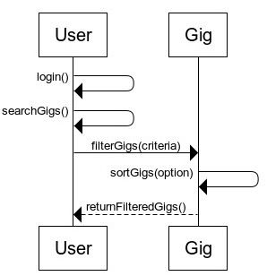
Freelance Forge Sequence Diagram Filter Jobs by Criteria (User Story 4.5)
User Story Outline:
1. User logs into their account.
2. User initiates a search before applying filters.
3. Applies multiple filters (e.g., price, category).
4. Sorts gigs by relevance, price.
5. Returns filtered and sorted list to the user.

Slide 2
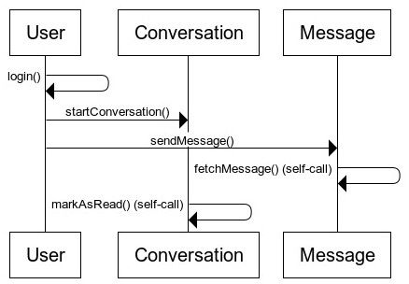
Real-Time Communication (User Story 6.4)
User Story Outline:
1. User logs into their account.
2. User starts a conversation.
3. User sends a real-time message.
4. Chat history is fetched.
5. Conversation is marked as read.

